Slide 1
Tibial Plafond Fractures
Nyakure

Slide 2
Incidence
Pilon fractures
account for <10% of lower extremity injuries
incidence increasing as survival rates after motor vehicle collisions increase
demographics
average patient age is 35-40 years
more common in males than females
high energy axial load (motor vehicle accidents, falls from height)

Slide 3
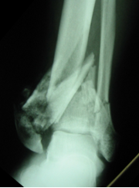
Picture

Slide 4
Characteristics
articular impaction and comminution
metaphyseal bone comminution
soft tissue injury (open or Tscherne II/III closed fractures)
associated musculoskeletal injuries: 75% have associated fibula fractures
3 fragments typical with intact ankle ligaments
medial malleolar (deltoid ligament)
posterolateral/Volkmann fragment (posterior inferior tibiofibular ligament)
anterolateral/Chaput fragment (anterior inferior tibiofibular ligament)

Slide 5
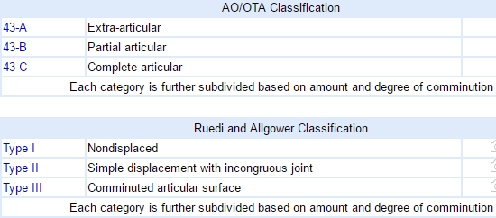
Classification

Slide 6
Clinical features
Symptoms
ankle pain, inability to bear weight, deformity
Physical exam
inspection
examine soft tissue integrity
swelling, abrasions, ecchymosis, fracture blisters, open wounds
examine for associated musculoskeletal injuries
ROM & stability
examine stability and alignment of the ankle joint
neurovascular
check DP and PT pulses
look for neurologic compromise
check for signs of compartment syndrome

Slide 7
Imaging
Radiographs
recommended views
AP, lateral, mortise views of ankle
full-length tibia/fibula and foot x-rays performed for fracture extension
CT scan
delineate articular involvement
surgical planning
most useful after ligamentotaxis is provided by a spanning external fixator

Slide 8
Non-op treatment
Immobilization
indications
stable fracture patterns without articular surface displacement
critically ill or nonambulatory patients
significant risk of skin problems (diabetes, vascular disease, neuropathy)
technique
long leg cast for 6 weeks followed by fracture brace and ROM exercises
alternative treatment is with early ROM
outcomes
intra-articular fragments are unlikely to reduce with manipulation of displaced fractures
loss of reduction is common
inability to monitor soft tissue injuries is a major disadvantage

Slide 9
Operative treatment
temporizing spanning external fixation across ankle joint: allows swelling to reduce
ORIF
Ex fix: definitively
IM nails

Slide 10
Complications
Wound slough
free flap for postoperative wound breakdown
Dehiscence : wait for soft tissue edema to subside before ORIF (1-2 weeks)
Infection
Varus malunion
Nonunion
Posttraumatic arthritis
most commonly begins 1-2 years post injury
Stiffness

